Slide 1
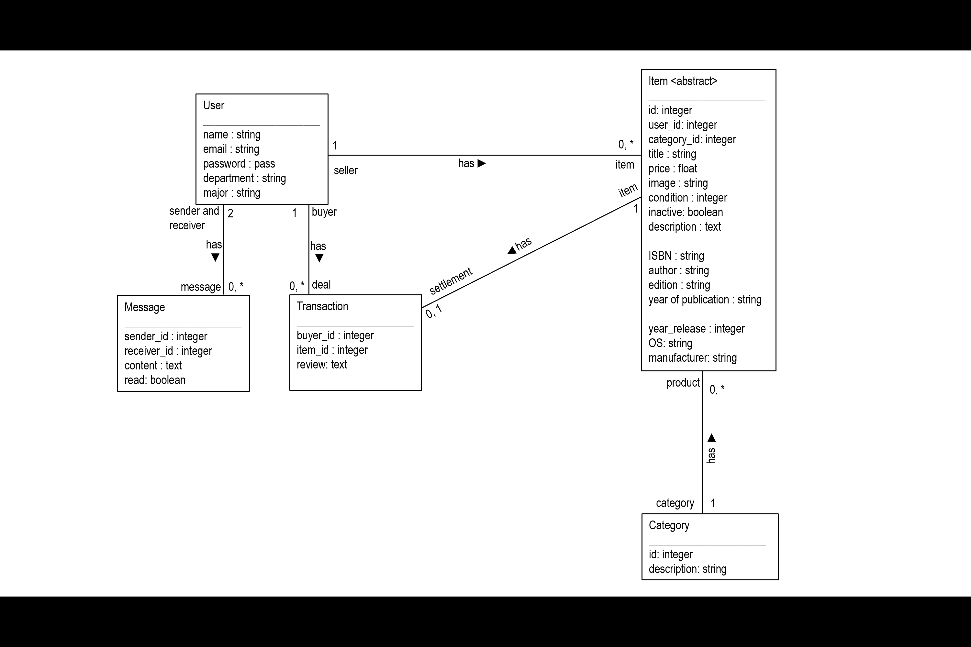

SellBackMart

Slide 2
Introduction
Introduction
Original idea from Ahuti Shrestha
Online marketplace for the University of Memphis students
A database driven web app

Slide 3
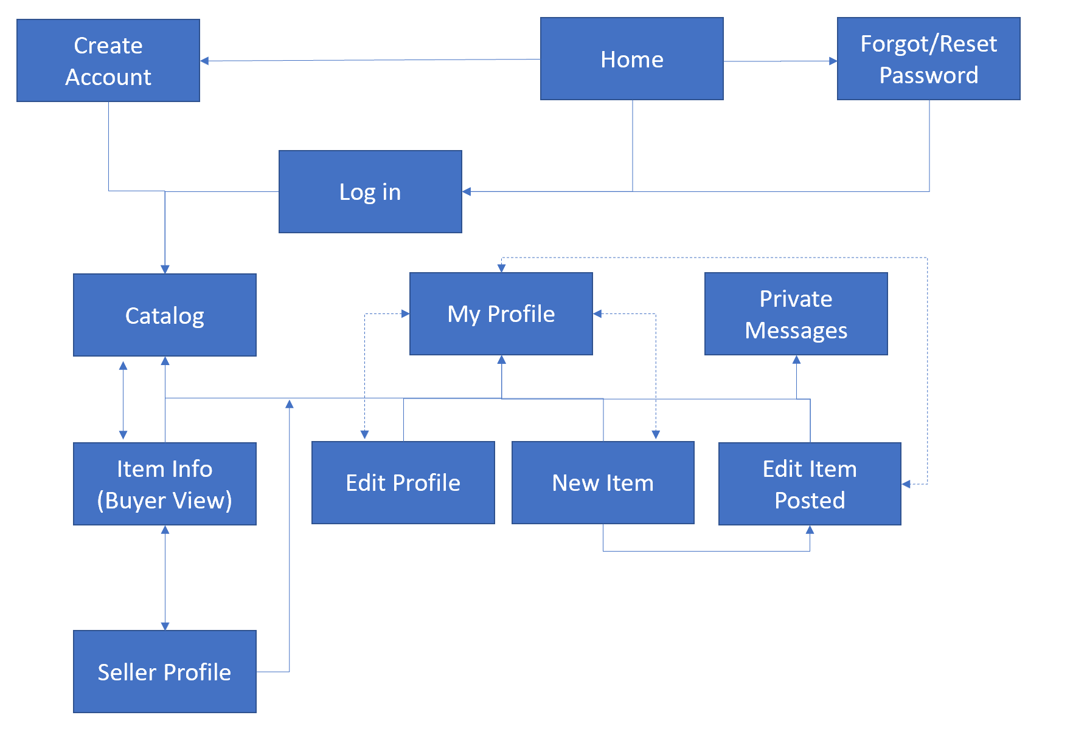
Design and Implementation
Design and Implementation
Site map
Model class diagram

Slide 4
Tasks Distribution
Andrew Edmiston
Item view
Category filter
Publish comment
Booth presentation
Felipe De Oliveira
Create models and database
Front page
User Logins and authentication
UI design
Rain (Yu) Sun
Set up model association
User profile view
My profile view
User activity history
Varun Negandhi
Post item
Edit item
Delete item
Upload item picture

Slide 5
